Slide 1
oTree: day 2
Filipp Chapkovski
April 4, 2017

Slide 2
What we gonna do today
Standard public good game
Public good game with voting
Public good game with punishment
mini-Ebay
customized waiting page

Slide 3
Multi-round PGG – how to do it
Contribution stage

Slide 4
Multi-round PGG – how to do it
Calculation of payoffs

Slide 5
Multi-round PGG – how to do it
showing results of previous rounds

Slide 6
Multi-round PGG – how to do it
Showing results of all rounds in the last page

Slide 7
Multi-round PGG – how to do it
shuffling players between the rounds

Slide 8
Multi-round PGG – how to do it
session settings – partner matching vs. random matching

Slide 9
Multi-round PGG – how to do it
participant.vars - gender

Slide 10
PGG with voting mechanism
procedure:
in the end of each round the smallest contributor leaves his/her group and joins another one.
in the beginning of each round his/her contributions are shown to the new group members and they vote whether they would like to have him or nor as a group member
If majority votes against, he skips the round

Slide 11
PGG with voting mechanism
procedure – phase 2:
if the player skipped the round X, in the next round he will be assigned to the new (or the same) group automatically.

Slide 12
PGG with voting mechanism
selecting the smallest contributor

Slide 13
PGG with voting mechanism
attaching the smallest contributor to the new group

Slide 14
PGG with voting mechanism
showing n last rounds to the rest of the group

Slide 15
PGG with voting mechanism
making voting mechanism

Slide 16
PGG with voting mechanism
dropping the unpopular candidate from the rest of the round

Slide 17
Public good game with punishment
the issue: we need ‘punishment matrix’
Group | Sender_id_in_group | Receiver_id_in_group | Punishment_sent

Slide 18
Public good game with punishment
Group | Sender_id_in_group | Receiver_id_in_group | Punishment_sent
1 | 1 | 2 | 5
1 | 2 | 3 | 10
1 | 1 | 3 | 15
for each player in a group: punishment sent: sum of punishment_sent if group=self.group and sender_id=self.id_in_group

Slide 19
Public good game with punishment
Group | Sender_id_in_group | Receiver_id_in_group | Punishment_sent
1 | 1 | 2 | 5
1 | 2 | 3 | 10
1 | 1 | 3 | 15
for each player in a group: punishment received: sum of punishment_sent if group=self.group and receiver_id=self.id_in_group

Slide 20
Public good game with punishment
adding random number of fields to model

Slide 21
Public good game with punishment
adding random number of fields in views

Slide 22
Public good game with punishment
looping through fields in template
looping through variables in template

Slide 23
oTree and mTurk
general info: what is Amazon mTurk?
“ An informal look at some of the data shows that males are particularly more likely to take HITs during working hours from 9 am to 5 pm. These data may suggest that during working hours Workers are likely to be unemployed males.”
Panos Ipeirotis (March 16, 2009). "Turker Demographics vs Internet Demographics". New York University.

Slide 24
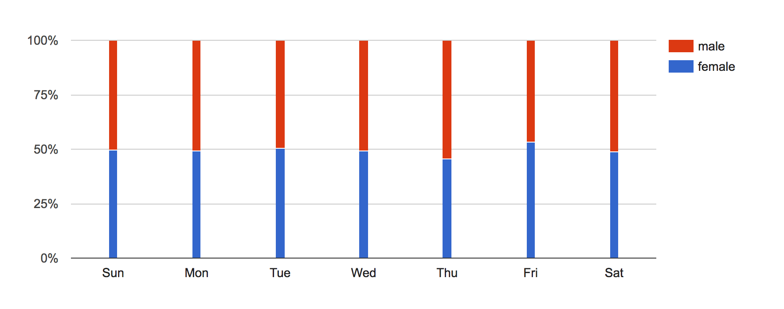
mTurk – gender
Ipeirotis, Panagiotis G. "Analyzing the amazon mechanical turk marketplace." XRDS: Crossroads, The ACM Magazine for Students 17.2 (2010): 16-21.
source: http://demographics.mturk-tracker.com/#/gender/all

Slide 25
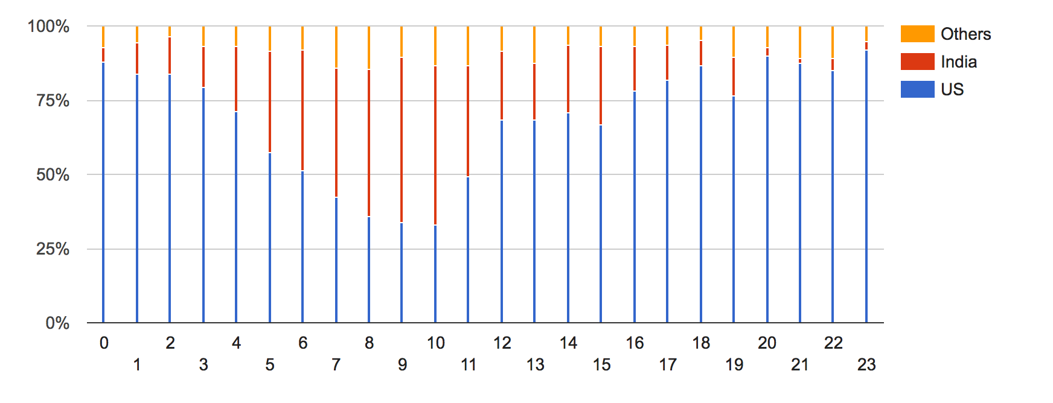
mTurk – per hour distribution across countries
Ipeirotis, Panagiotis G. "Analyzing the amazon mechanical turk marketplace." XRDS: Crossroads, The ACM Magazine for Students 17.2 (2010): 16-21.
source: http://demographics.mturk-tracker.com/#/gender/all

Slide 26
mTurk
“ An informal look at some of the data shows that males are particularly more likely to take HITs during working hours from 9 am to 5 pm. These data may suggest that during working hours Workers are likely to be unemployed males.”

Slide 27
http://www.newyorker.com/culture/culture-desk/video-turking-for-respect
http://www.pbs.org/newshour/updates/inside-amazons-hidden-science-factory/
Jiang, Ling, Christian Wagner, and Bonnie Nardi. "Not Just in it for the Money: A Qualitative Investigation of Workers' Perceived Benefits of Micro-task Crowdsourcing." System Sciences (HICSS), 2015 48th Hawaii International Conference on. IEEE, 2015.

Slide 28
The MTurk population convenience sample (surveying a population based on available respondents) had 60% female and 83.5% white participants, with a mean age of 32.2 and 14.9 years of education. Earlier student samples had a mean age of 20.3 years, while adult samples had 75.5% female participants with 5.48 years of education. “The MTurk respondent pool has attractive characteristics — even apart from issues of cost.”
The MTurk sample was only slightly more female (60% versus 58%) and less educated (14.9 years of schooling versus 16.2) than the 2008 American National Election Panel Study. Its study participants were also more interested in politics in general, more likely to identify as Democrats and “substantially more liberal in their ideology.”
MTurk recruits “fare worse in comparison to [traditional national surveys] on demographic characteristics related to life cycle events.” Recruits are more likely to live in the northeastern United States, have never married (51%), rent versus own their home (53%) and not be affiliated with a major religion (42%).
With respect to the costs associated with study participant identification and recruitment, “even the highest pay rate we have used on MTurk of $.50 for a 5-min survey (an effective hourly rate of $6) is still associated with a per-respondent cost of $.55 (including Amazon.com’s 10% surcharge) or $.11 per survey minute. By contrast, per subject costs for typical undergraduate samples are about $5 to $10, for non-student campus samples about $30 … and for temporary agency subjects between $15 and $20.”
Berinsky, Adam J., Gregory A. Huber, and Gabriel S. Lenz. "Evaluating online labor markets for experimental research: Amazon. com's Mechanical Turk." Political Analysis 20.3 (2012): 351-368.

Slide 29
reputation
turkoptikon (ver 2.)

Slide 30
issues
Krupnikov, Yanna, and Adam Seth Levine. "Cross-sample comparisons and external validity." Journal of Experimental Political Science 1.1 (2014): 59.
Chandler, Jesse, Pam Mueller, and Gabriele Paolacci. "Nonnaïveté among Amazon Mechanical Turk workers: Consequences and solutions for behavioral researchers." Behavior research methods 46.1 (2014): 112-130.

Slide 31
mturk and otree
settings.py:
AWS_ACCESS_KEY_ID = environ.get('AWS_ACCESS_KEY_ID')
AWS_SECRET_ACCESS_KEY = environ.get('AWS_SECRET_ACCESS_KEY')

Slide 32
mturk and otree
settings.py:
AWS_ACCESS_KEY_ID = environ.get('AWS_ACCESS_KEY_ID')
AWS_SECRET_ACCESS_KEY = environ.get('AWS_SECRET_ACCESS_KEY')

Slide 33
mturk and otree
mturk_hit_settings = {
'keywords': ['easy', 'bonus', 'choice', 'study'],
'title': 'Title for your experiment',
'description': 'Description for your experiment',
'frame_height': 500,
'preview_template': 'global/MTurkPreview.html',
'minutes_allotted_per_assignment': 60,
'expiration_hours': 7*24, # 7 days
}

Slide 34
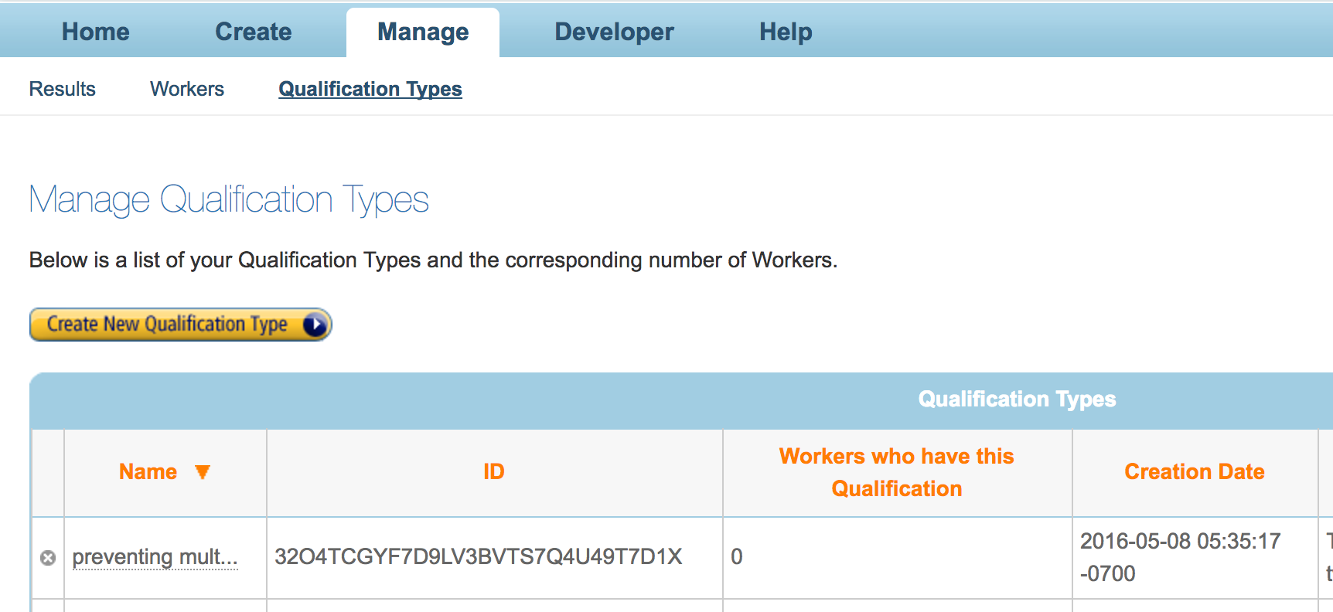
mTurk and oTree

Slide 35
# 'grant_qualification_id': 'YOUR_QUALIFICATION_ID_HERE',# to prevent retakes
'qualification_requirements': [
# qualification.LocaleRequirement("EqualTo", "US"),
# qualification.PercentAssignmentsApprovedRequirement("GreaterThanOrEqualTo", 50),
# qualification.NumberHitsApprovedRequirement("GreaterThanOrEqualTo", 5),
# qualification.Requirement('YOUR_QUALIFICATION_ID_HERE', 'DoesNotExist')
]

Slide 36
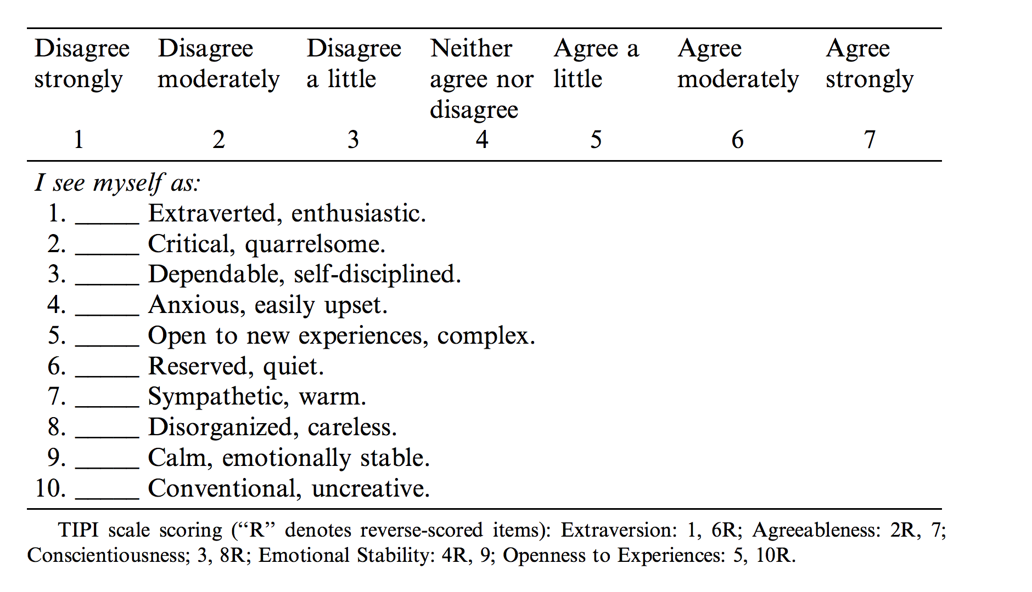
Big Five
http://gosling.psy.utexas.edu/scales-weve-developed/ten-item-personality-measure-tipi/ten-item-personality-inventory-tipi/
Gosling, Samuel D., Peter J. Rentfrow, and William B. Swann. "A very brief measure of the Big-Five personality domains." Journal of Research in personality 37.6 (2003): 504-528.

Slide 37
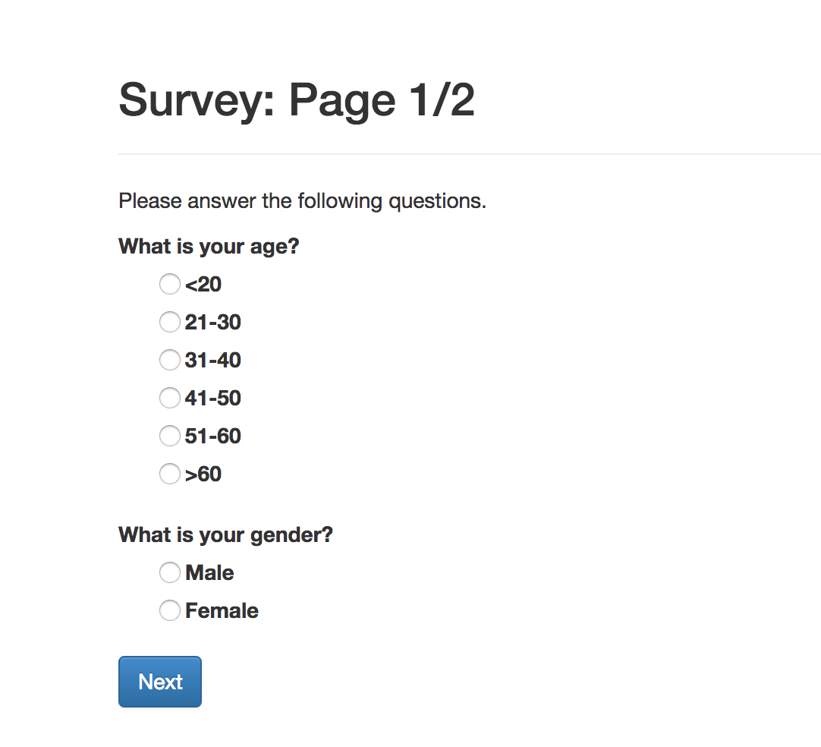

Slide 38
